Slide 1
1.Multidisciplinary nature Of ES
PEOPLE IN THE ENVIRONMENT

Slide 2
PEOPLE IN THE ENVIRONMENT
There are several internationally known environmental thinkers.
Among those who have made landmarks, signicant contributions are:
Charles Darwin,
Ralph Emerson,
Henry Thoreau,
John Muir,
Aldo Leopald, Rachel Carson and
EO Wilson.
Every one looked at the environment from a completely different perspective.

Slide 3
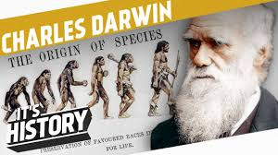
Charles Darwin
He wrote the ‘Origin of Species’, which brought to light the close relationship between habitats and species.
It brought about a new thinking of man’s relationship with other species that was based on evolution.
Alfred Wallace came to the same conclusions during his work.

Slide 4
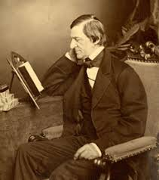
People in the environment
Ralph Emerson :
spoke of the dangers of commerce to our environment way back in the 1840s.
Henry Thoreau : In the 1860s wrote that the wilderness should be preserved after he lived in the wild for a year.
He felt that most people did not care for nature and would sell it off for a small sum of money.

Slide 5
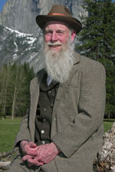
People in the environment
John Muir : saved the great ancient sequoia trees in California’a forests.
In the 1890s he formed the Sierra club, which is a major conservation NGO in the USA.

Slide 6
People in the environment
Aldo Leopald :
He was a forest official in the US in the 1920s. He designed the early policies on wilderness conservation and wildlife management.
Rachel Carson :
She published several articles in the 1960s that caused immediate worldwide concern on the effects of pesticides on nature and mankind.
She wrote a well known book called ‘Silent Spring’ which eventually led to a change in Government policy and public awareness

Slide 7
People in the environment
EO Wilson :
He is an entomologist who envisioned that biological diversity was a key to human survival on earth.
He wrote ‘Diversity of Life’ in 1993, which was awarded a prize for the best book published on environmental issues.
His writings shown to the world the risks to mankind due to man made disturbances in natural ecosystems that are leading to the rapid extinction of species at the global level.

Slide 8
People in the environment
Some of the well known names in the last century include environmentalists, scientists, administrators, legal experts, educationists and journalists.
Salim Ali’s name is synonymous with ornithology in India and with the Bombay Natural History Society (BNHS).
He also wrote several great books including the famous ‘Book of Indian Birds’.
His autobiography, ‘Fall of a Sparrow’ should be read by every nature enthusiast.
He was our country’s leading conservation scientist and influenced environmental policies in our country for over 50 years.

Slide 9
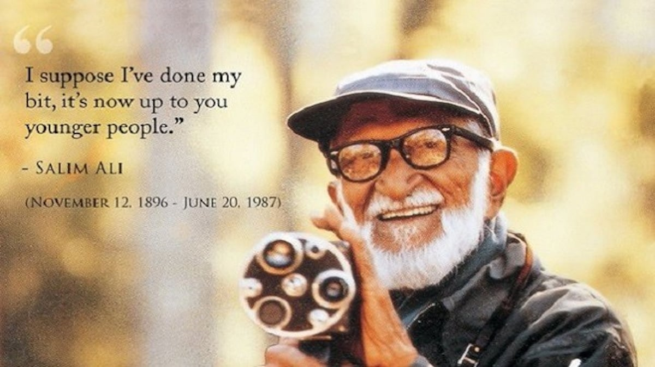
Dr. SALIM ALI

Slide 10
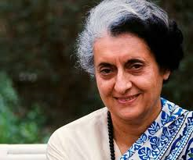
People in the environment Indira Gandhi
Indira Gandhi as PM of India has played a highly significant role in the preservation of India’s wildlife.
It was during her period as Prime Minister of India:
The network of Pas (Protected Areas) grew from 65 to 298!
The Wildlife Protection Act (1972) was formulated and
The Indian Board for Wildlife was extremely active as she personally chaired all its meetings.

Slide 11
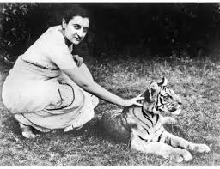
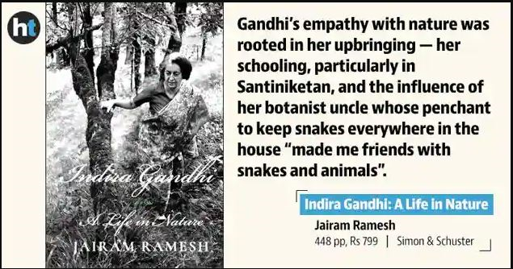
India gained a name for itself by being a major player in CITES - the Convention on International Trade in Endangered Species of Wild Fauna and Flora & other International Environmental Treaties and Accords during her tenure.
BNHS frequently used her good will to get conservation action initiated by the Governement.

Slide 12
M S Swaminathan
Mankombu Sambasivan Swaminathan is an Indian geneticist and administrator, known for his role in India's Green Revolution, a program under which high-yield varieties of wheat and rice were planted.
He is India’s foremost agricultural scientists and has also been concerned with various aspects of biodiversity conservation both of cultivars and wild biodiversity.
He has founded the MS Swaminathan Research Foundation in Chennai, which does work on the conservation of biological diversity

Slide 13
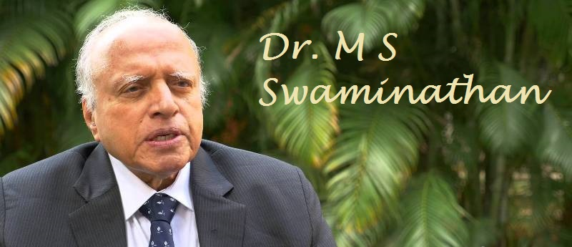
Dr.Mankombu Sambasivan Swaminathan
Indian geneticist, Green Revolution in India

Slide 14
S P Godrej
He was one of India’s greatest supporters of wildlife conservation and nature awareness programs.
Between 1975 and 1999, SP Godrej received 10 awards for his conservation activities.
He was awarded the Padma Bhushan in 1999.
His friendship with people in power combined with his deep commitment for conservation led to his playing a major advocacy role for wildlife in India.

Slide 15
Madhav Gadgil
is a well known ecologist in India.
His interests :
ecological issues such as developing Community Biodiversity Registers and
conserving sacred groves
studies on the behavior of mammals, birds and insects.
He has written several articles, published papers in journals and is the author of 6 books.

Slide 16
M C Mehta
He is undoubtedly India’s most famous environmental lawyer.
Since 1984, he has filed several Public Interest Litigations for supporting the cause of environmental conservation.
His most famous and long drawn battles supported by the Supreme Court include:
protecting the Taj Mahal,
cleaning up the Ganges River,
banning intensive shrimp farming on the coast,
initiating Government to implement environmental education in schools and colleges, and a variety of other conservation issues.

Slide 17
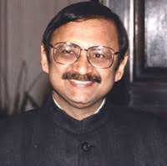
Anil Agarwal :
A journalist who wrote the first report on the ‘State of India’s Environment’ in 1982.
He founded the Center for Science and Environment which is an active NGO that supports various environmental issues, currently led by Sunita Narain.

Slide 18
Sunderlal Bahugna’s Chipko Movement
has become an internationally wellknown example of a highly successful conservation action program through the efforts of local people for guarding their forest resources.
His fight to prevent the construction of the Tehri Dam in a fragile earthquake prone setting is a battle that he continues to wage.
The Garhwal Hills will always remember his dedication to the cause for which he has walked over 20000kilometers.

Slide 19
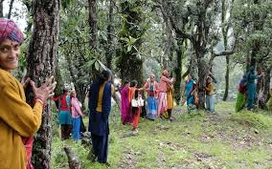
Chipko movement

Slide 20
Medha Patkar is known as one of India’s champions who has supported the cause of downtrodden tribal people whose environment is being affected by the dams on the Narmada river.
NBA – Narmada bachao andolan

Slide 21
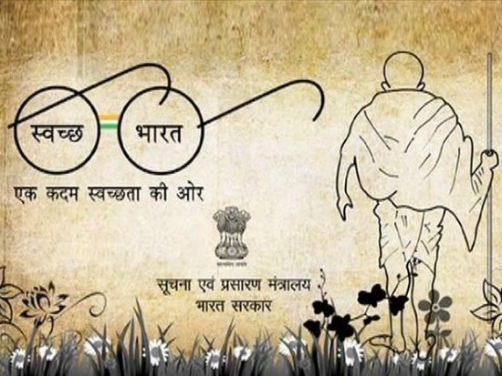
PEOPLE IN THE ENVIRONMENT

Slide 22
END OF THE CHAPTER
____________________________
THANK YOU

